Slide 1
Shri Chhatrapati Shivaji College, Omerga
Dept. of Comp. Sci. & I T
Cloud Computing Applications for
Rural Development
Shelke Bharat Abhimanyu
Dept. of Computer Science
S.C.S. College, Omerga,
Dist. Osmanabad (Maharashtra)
E-mail – bharat_shelke@rediff.com
Cell +91 9975561687

Slide 2
Contents
Cloud Computing Basics
Advantages of using Cloud Computing
Limitations
Conclusion
Introduction
Applications of Cloud Computing for Rural Development

Slide 3
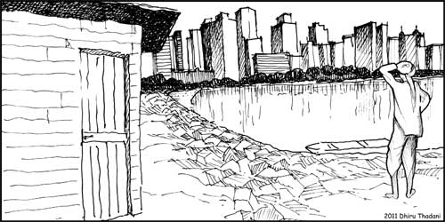
Introduction
The future of India lies in its
Villages
In India 72% population resides in rural areas. Computer literacy is 40- 50% in most of the regions.
Agriculture is India's biggest employment source, 52% employment in India and agricultural sector contributes to 20% of country's total GDP.
So it is very important to make a serious attempt to develop rural India.
Rural development can be in the form of education, agriculture, health, culture or in any other fields.
Now a days most of the villages have access to cellular phone and internet.
So there is technical feasibility of establishing Computer systems.
Notes:
Mahatama Ghandi’s quote is “ The Future of India lies in its Villages”
In India 72% population resides in rural areas. Computer literacy is 40- 50% in most of the regions.
Agriculture is India's biggest employment source, 52% employment in India and agricultural sector contributes to 20% of country's total GDP. (Gross domestic product - an aggregate measure of production.
So it is very important to make a serious attempt to develop rural India.
Rural development can be in the form of education, agriculture, health, culture or in any other fields.
Now a days most of the villages have access to cellular phone and internet.
So there is technical feasibility of establishing computer systems.

Slide 4
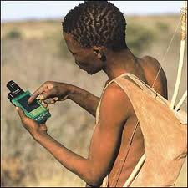
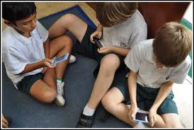
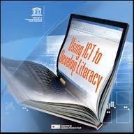
Literacy
Media Literacy
Information Literacy
Technology Literacy
Notes:
In above images, I shows that, In India, rural peoples are used the Mobiles, Computers but they have not collect the required information through this technology, They need the advanced techniques to give the knowledge from these devices.

Slide 5
Cont...
Rural people also access the web based application with the help of tablets and mobile phones.
We think this growth rate can be enhanced if the Computing system is really cheap, easy to operate with minimum level of knowledge,
Essentially if the system is helpful to improve their life style.
Lack of awareness to the power and capability of Information technology, people in the rural areas are deprived of business opportunities, healthcare facilities, quality education, good farming practices and employment opportunities because of the huge costs incurred on infrastructure, software etc.
The main aim of the system is to make the people in rural areas to have access to recent technology.
With the help of the Computing system enhance their standard of living and also this would lead to a greater good of developing the nation.
Notes:
Rural people also access the web based application of cloud computing with the help of tablets and mobile phones.
We think this growth rate can be enhanced if the computing system is really cheap, easy to operate with minimum level of knowledge, without upfront commitment and more essentially if the system is helpful to enhance their life style.
Lack of awareness to the power and capability of Information technology, people in the rural areas are deprived of business opportunities, healthcare facilities, quality education, good farming practices and employment opportunities because of the huge costs incurred on infrastructure, software etc.
The main aim of the system is to make the people in rural areas to have access to recent technology and with the help of the computing system enhance their standard of living and also this would lead to a greater good of developing the nation.

Slide 6
Population in India
Year | Urban | Rural
1951 | 17% | 83%
1961 | 18% | 82%
1971 | 20% | 80%
1981 | 24% | 76%
1991 | 26% | 74%
2001 | 28% | 72%
2011 (P) | 31% | 68.85%
Notes:
This is the India population graph,
This shows that,
The population of rural area is decreased and urban area is increased.
Peoples from rural areas are moved to Urban area for jobs, because in rural area there are so many problems.
No proper environment for agriculture, education, employment, no factories, no any sources.

Slide 7
Agricultural Development
Availability of Jobs
Infrastructural Development
Adoption of New technology
Rural Industrialization
Rural Development- Means Overall Development of the Villages
Social and Cultural Development
Health Facilities
Education Facilities
Better Standard of Living
Food Security
Drinking Water Facilities
Housing Facilities
Notes:
Rural Development means overall development of Villages i.e.
Agriculture development, Infrastructure development, Rural Industrialization, Health Facilities, Education Facilities, Food Security, Housing facilities, Drinking water facilities, Better standard living, social and culture development, Adoption of New technology, Availability of jobs.
So, main considerable issues are Education Facilities, Jobs, and adoption of New technology.
Rural people can also understands the use & application of new technologies, and implement in your own villages place.
All issues automatically solves.

Slide 8
New Technology
Cont...
Rural people can adapt New information technology i.e.
”Cloud Computing”
A network based computing model for enabling convenient, on-demand network access to a shared pool of configurable computing resources
Cloud computing is aimed at providing IT as a service to the cloud users on-demand basis.
This new paradigm of computing has an immense potential in it to be used in the field of rural development.
In the context of rural development Cloud Computing can also be used to success for its centralized storage and computing facility and utility based pay model.
Notes:
Rural people can adapt New information technology i.e. “cloud computing,”
A network based computing model for enabling convenient, on-demand network access to a shared pool of configurable computing resources (e.g., networks, servers, storage, applications, and services) that can be rapidly provisioned and released with minimal management effort or service provider interaction.
Cloud computing is aimed at providing IT as a service to the cloud users on-demand basis with greater availability, reliability and scalability with utility computing model.
This new paradigm of computing has an immense potential in it to be used in the field of rural development.
In the context of rural development cloud computing can also be used to success for its centralized storage and computing facility and utility based pay model.

Slide 9
Cloud Computing Basics
Definition:
Cloud computing is a model for enabling convenient, on-demand network access to a shared pool of configurable computing resources.
(e.g., networks, servers, storage, applications, and services) that can be rapidly provisioned and released with minimal management effort or service provider interaction.”
Notes:
Definition:
Cloud computing is a model for enabling convenient, on-demand network access to a shared pool of configurable computing resources (e.g., networks, servers, storage, applications, and services) that can be rapidly provisioned and released with minimal management effort or service provider interaction.”

Slide 10
Cloud : Deployment Models
1. Public Cloud: The cloud infrastructure applications, storage, and other resources are made available to the general public or large group of companies.
2. Private Cloud: The cloud infrastructure is operated for a single organization. It may be owned, managed and operated by the organization or a third party, and may exist on-premises.
3. Community Cloud: The cloud shares infrastructure for specific community with common concerns whether managed internally or by a third-party.
4. Hybrid Cloud: The cloud infrastructure is a composition of two or more clouds (private, community, or public).
Notes:
Public cloud: The cloud infrastructure applications, storage, and other resources are made available to the general public or large group of companies.
2. Private cloud: The cloud infrastructure is operated solely for a single organization. It may be owned, managed and operated by the organization or a third party, and may exist on-premises or off-premises.
3. Community cloud: The cloud shares infrastructure for specific community with common concerns whether managed internally or by a third-party and hosted internally or externally.
4. Hybrid cloud: The cloud infrastructure is a composition of two or more clouds (private, community, or public).

Slide 11
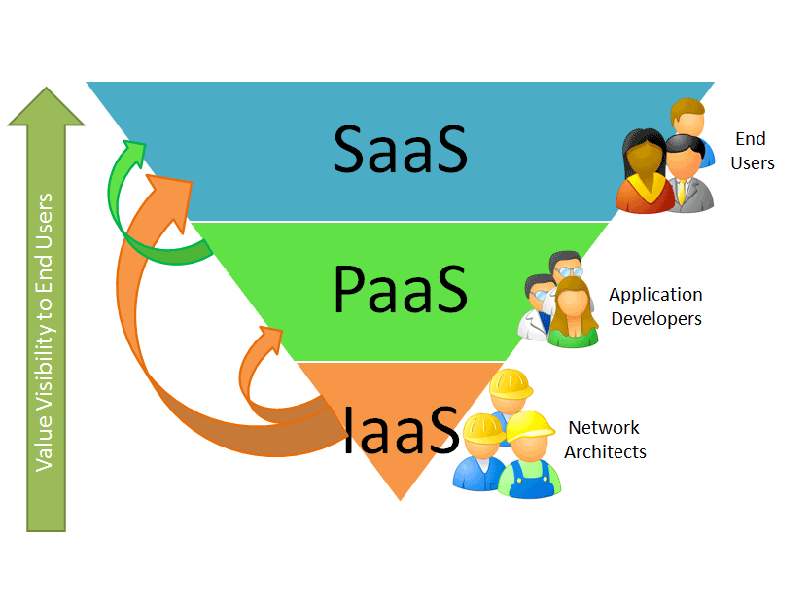
Cloud : Service Models
1. Software-as-a-Service (SaaS)
SaaS provides the users a complete application of the user interface to the application itself.
Applications are useful to end users.
2. Platfarm-as-a-Service (PaaS) It delivers a computing platform as a
service where the developers can develop their own applications using web based tools and run them on systems software and hardware provided by another company.
3. Infrastructure-as-a-Service (IaaS)
It is a model of software deployment where an application is hosted as a service provided to customers across the Internet.
Notes:
1. Software-as-a-Service (SaaS)
It delivers computer infrastructure as a service.
So instead of purchasing servers, processors,
data center space, memory, network equipments
etc clients buy them as a fully outsourced service.
2. Platfarm-as-a-Service (PaaS)
It delivers a computing platform as a service where
the developers can develop their own applications using web based tools and run them on
systems software and hard-ware provided by another company.
3. Infrastructure-as-a-Service (IaaS)
It is a model of software deployment where an application is hosted as a service provided to customers across the Internet.

Slide 12
Applications of Cloud Computing for Rural Development
Education:
Rural education facing problems like lack of qualified teachers, lack of IT institutes with proper infrastructure and teaching facilities, lack of involvement and control of educational matters and difficulties of students in higher education.
Lack of IT study institutes in rural areas because of the huge amount of money spent on buying software licenses, setting up proper infrastructure is required for computation, storage etc.
The three fundamental services offered by cloud computing i.e. IaaS, PaaS and SaaS will reduce the total expenses on setting up an IT institute by vast amount because
• There is no need to buy expensive software licenses .
There is no need to setup expensive infrastructure.
There is no cost for maintenance of infrastructure - mainly software and hardware.
To get benefitted by cloud computing model a Web based education system can be developed and deployed on the Cloud.
On Cloud free education material (video lectures, powerpoint slides, eBooks, 3D diagrams and animations.
Students would be able to access the web based education system without purchasing any licensed software, can share knowledge by communicating between schools handling the same curriculum
Notes:
Education:
Rural education facing problems like lack of qualified teachers, lack of IT institutes with proper infrastructure and teaching facilities, lack of involvement and control of educational matters and difficulties of students in higher education.
Lack of IT study institutes in rural areas because of the huge amount of money spent on buying software licenses, setting up proper infrastructure is required for computation, storage etc.
The three fundamental services offered by cloud computing i.e. IaaS, PaaS and SaaS will reduce the total expenses on setting up an IT institute by huge amount because
• There is no need to buy expensive software licenses .
There is no need to setup huge and expensive infrastructure.
There is no cost for maintenance of infrastructure - mainly software and hardware.
To get benefitted by cloud computing model a Web based education system can be developed and deployed on the Cloud.
On Cloud free education material (video lectures, powerpoint slides, eBooks, 3D diagrams and animations.
Students would be able to access the web based education system without purchasing any licensed software, can share knowledge by communicating between schools handling the same curriculum

Slide 13
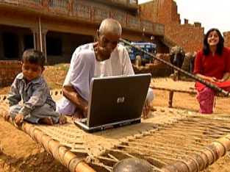
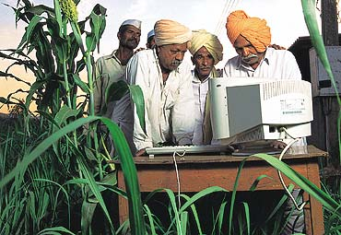
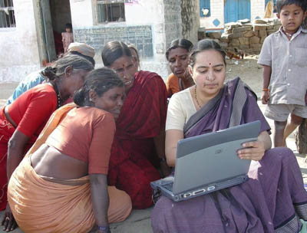
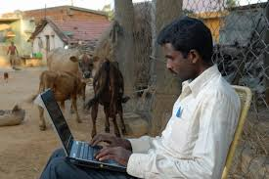
Computer Literacy in Villages
Education:

Slide 14
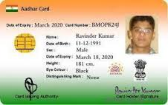
Applications of Cloud Computing for Rural Development
2. Aadhaar (Unique Identification of People):
Aadhaar card used instead of Voter ID Card, Address Proof like Electricity Bill, Rashan Card etc.
Aadhaar is the single source of identity verification to access services such as obtaining a bank account, passport, driving license and so on.
Cloud-computing infrastructure for Aadhaar:
A Cloud Based Management Information System (CBMIS) can be developed for authenticating the identity of an individual. The use of Aadhaar-based authentication linked to a cloud
based management information system (MIS) would enable the public distribution system (PDS) to address broader procurement, mass storage and monitoring challenges online in real-time.
Aadhaar-based authentication to government useful for
Food delivery to the poor peoples.
Keep the storage and timely distribution of food grain.
Detection of frauds, improper or duplicate claims can be monitored.
An SMS alert containing information quantity of grain & its prices
Notes:
2. Aadhaar (Unique Identification of People):
UID the Common People one and only single used instead of Voter ID Card, Address Proof like Electricity Bill, Rashan Card etc.
Aadhaar is the single source of identity verification to access services such as obtaining a bank account, passport, driving license and so on.
Cloud-computing infrastructure for Aadhaar:
A Cloud Based Management Information System (CBMIS) can be developed for authenticating the identity of an individual. The use of Aadhaar-based authentication linked to a cloud based management information system (MIS) would enable the public distribution system (PDS) to address broader procurement, mass storage and monitoring challenges online in real-time.
Aadhaar-based authentication to government useful for
Food delivery to the poor.
Keep the storage and timely distribution of food grain.
Detection of frauds, improper or duplicate claims can be monitored.
An SMS alert containing information quantity of grain & its prices

Slide 15
Applications of Cloud Computing for Rural Development
3. Health care:
The National Rural Health Mission (NRHM) is a government scheme that aims at providing valuable healthcare services to rural households all over the country.
An web based application informing the facilities can be deployed on cloud infrastructure which will enable people in rural areas:
To access Hospitals' Database to check the location of hospitals nearby.
To get advised by the specialists in metro cities ad-vice through Audio/video/web conferencing, with-out going there personally.
To get cost effective consultation, prescription on-line.
With shortage of medical resources in the country, it may be useful to have medical expertise of good doctors wherever needed through internet.
To talk to service help desk number obtained from the web based application for advice in case of small injuries and health related problems.
Notes:
3. Health care:
The National Rural Health Mission (NRHM) is a government scheme that aims at providing valuable healthcare services to rural households all over the country. An web based application informing the facilities offered by NRHM can be deployed on cloud infrastructure which will enable people in rural areas:
To access Hospitals' Database to check the location of hospitals nearby.
To get advised by the specialists in metro cities ad-vice through Audio/video/web conferencing, with-out going there personally.
To get cost effective consultation, prescription on-line.
With shortage of medical resources in the country, it may be useful to have medical expertise of good doctors wherever needed through internet.
To talk to service help desk number obtained from the web based application for advice in case of small injuries and health related problems.

Slide 16
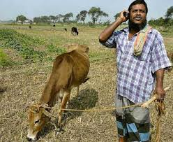
Applications of Cloud Computing for Rural Development
4. Agriculture:
People from rural areas are unable to sell their own production
in the market directly. Many brokers/agents pop up in between
the retail and the production which ultimately leads exploitation
of the farmers.
If the farmers involve themselves in e-commerce and sell their produced items directly to the end users/retailers which is very much possible with Agriculture management information system with the use of Cloud Computing.
A Web based Agriculture management information system can be useful in agriculture field as it brings latest bulletins regarding weather reports, prices, fertilizer, sowing of crops and its pricing etc., to farmers at rural areas.
Scientists working at Agriculture research stations can add their discoveries, suggestions regarding modern techniques for cultivation, usage of fertilizers in the cloud, can obtain cultivation history of the region etc.
Sales to customers and planting (producing) for cultivated land can be performed together.
Query for information and access free of cost from free services or by paying less amount for pay services are also available on Cloud.
Notes:
People from rural areas are unable to sell their own production
in the market directly. Many brokers/agents pop up in between
the retail and the production which ultimately leads exploitation
of the farmers.
If the farmers involve themselves in e-commerce and sell their produced items directly to the end users/retailers which is very much possible with Agriculture management information system with the use of cloud computing.
A Web based Agriculture management information system can be useful in agriculture field as it brings latest bulletins regarding weather reports, prices, fertilizer, sowing of crops and its pricing etc., to farmers at rural areas.
Scientists working at Agriculture research stations can add their discoveries, suggestions regarding modern techniques for cultivation, usage of fertilizers in the cloud, can obtain cultivation history of the region etc.
Sales to customers and planting (producing) for cultivated land can be performed together.
Query for information and access in no time at free of cost from free services or by paying less amount for pay services are also available.

Slide 17
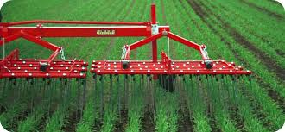
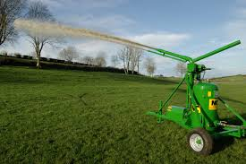
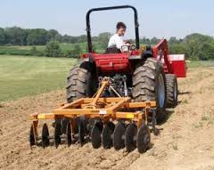
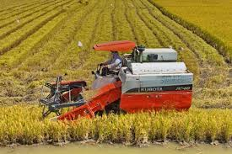
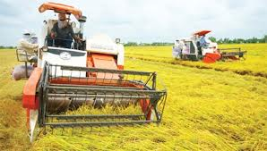
Agriculture related machineries
Notes:
In rural area the workers problem,
Rural people can also used the modern technology for agriculture work.
In above figure I shows that there are so many BIG machinery available for agriculture purpose.

Slide 18
With the help of cloud computing this can be made possible
No too much Investment:
The villagers need not to invest too much to buy computing system, but instead they can have very low cost terminals with basic functionality of I/O and have a network access.
No maintenance issues:
The users need not to be an expert for maintenance. This solves the unavailability of technical experts in the remote villages as the maintenance issues are handled by the cloud provider explicitly.
Upgraded version of hardware and software:
The users always use the upgraded version of software and hardware as maintained by the cloud provider. This reduces the cost of up gradation.
On-demand resource allocation:
The virtual resources can be extended as needed. If the user needs more resource then it is provided on demand basis.
Utility computing model:
The economic model used by the cloud is pay-as-you- use. This enables the users handle the cost they have to pay. By using cloud computing model some improvement of the current system is possible to bring about social and as well as economic prospect in rural India.
Notes:
The villagers have to own a PC :
To use traditional web services through internet the villagers need to own a PC which would increase their investment. Then the issues of need for technical experts for software/hardware installation and maintenance are needed. Upgradation of software or hardware would be a problem both economically and technically.
With the help of cloud computing this can be made possible
No upfront commitment:
The villagers need not to invest too much to buy computing system, but instead they can have very low cost terminals with basic functionality of I/O and have a network access.
No maintenance issues:
The users need not to be an expert for maintenance. This solves the unavailability of technical experts in the remote villages as the maintenance issues are handled by the cloud provider explicitly.
Upgraded version of hardware and software:
The users always use the upgraded version of software and hardware as maintained by the cloud provider. This reduces the cost of up gradation.
On-demand resource allocation:
The virtual resources can be extended as needed. If the user needs more resource then it is provided on demand basis.

Slide 19
With the help of cloud computing this can be made possible
Share knowledge and build knowledge database:
Most of the agriculture related issues are generally local and they can't be solved by general expertise. So it happens many times that the so called experts are not the right person to answer the problems but instead the local farmers are better in understanding. So in these situations better solution can be given by the local experts. If these local experts access a common space to share their knowledge then others eventually come to know about the solution. Thus a knowledge base can be build which would represent the issues in that local scenario.
Government decision making:
Looking at the common knowledge base the Government can have a fair knowledge of the local situation and take adoptive steps.
Access to Information hub:
Government can provide relevant information such as land revenue data, weather data, soil information etc. through these cloud services to the people concerned. All these things are possible with right initiative. These may need customizing the original cloud services.
Management of all data related to land, including location, area; soil and land characteristics can be integrated.
Reports can be easily issued by sharing on-site photographs to administrators and workers.
Cloud based agriculture system can benefit Government officials/private organizations by obtaining/ inserting information regarding pricing of crops, supply of seeds, farming of lands at various places.
Notes:
Utility computing model:
The economic model used by the cloud is pay-as-you- use. This enables the users handle the cost they have to pay. By using cloud computing model some improvement of the current system is possible to bring about social and as well as economic prospect in rural India.
Share knowledge and build knowledge base:
Most of the agriculture related issues are generally local and they can't be solved by general expertise. So it happens many times that the so called experts are not the right person to answer the problems but instead the local farmers are better in understanding. So in these situations better solution can be given by the local experts. If these local experts access a common space to share their knowledge then others eventually come to know about the solution. Thus a knowledge base can be build which would represent the issues in that local scenario.
Government decision making:
Looking at the common knowledge base the Government can have a fair knowledge of the local situation and take adoptive steps.
Access to Information hub:
Government can provide relevant information such as land revenue data, weather data, soil information etc. through these cloud services to the people concerned. All these things are possible with right initiative. These may need customizing the original cloud services.
Management of all data related to land, including location, area; soil and land characteristics can be integrated.
Reports can be easily issued by sharing on-site photographs to administrators and workers.
Cloud based agriculture system can benefit Government officials/private organizations by obtaining/ inserting information regarding pricing of crops, supply of seeds, farming of lands at various places.

Slide 20
Advantages of using Cloud Computing
Lower Computer costs:
As the cloud computing are web based, and are run in the cloud desktop PC, lap-tops, tablets does not need the processing power or hard disk space.
Improved performance:
Computers in a cloud computing system boot and run faster because they have fewer programs and processes loaded into memory.
Reduced Software costs:
Instead of purchasing licensed software applications, it can be accessed for free.
Unlimited data storage capacity and increased data reliability:
A computer in the cloud can store hundreds of Petabytes of data in the cloud and crashing in the cloud does not affect the storage of data.
Universal document access:
Document stay in the cloud, and can be accessed through an Internet connection
Device independence:
Changes to computers, applications and documents follow you through the cloud.
Notes:
Lower computer costs:
As the cloud computing are web based, and are run in the cloud desktop PC, lap-tops, tablets does not need the processing power or hard disk space.
Improved performance:
Computers in a cloud computing system boot and run faster because they have fewer programs and processes loaded into memory.
Reduced software costs:
Instead of purchasing licensed software applications, it can be accessed for free.
Unlimited data storage capacity and increased data reliability:
A computer in the cloud can store hundreds of Petabytes of data in the cloud and crashing in the cloud does not affect the storage of data.
Universal document access:
Document stay in the cloud, and can be accessed through an Internet connection
Device independence:
Changes to computers, applications and documents follow you through the cloud.

Slide 21
Limitations
Requires a high speed internet connection.
If the cloud servers happen to be backed up at that moment, or if the Internet is having a slow day.
We would not get the instant access we might expect from desktop applications.
Notes:
Requires a high speed internet connection.
If the cloud servers happen to be backed up at that moment, or if the Internet is having a slow day
We would not get the instant access we might expect from desktop applications.

Slide 22
Conclusion
Cloud will continue to evolve as the foundation for the future internet where we will be interconnected in a web of content and services.
Information technology in rural areas will not only benefit the people there but also the software providers by changing the role of IT people from technical support to project manager, business analyst, quality analyst, software developer.
The widespread use of pirated software can be controlled using cloud as the software’s are available at lower costs in the cloud and hence benefitting the software providers.
By using cloud computing as an opening into the fields where IT is yet to be applied it is possible to establish new models for the application of IT.
Notes:
Cloud will continue to evolve as the foundation for the future internet where we will be interconnected in a web of content and services.
The introduction of information technology in rural areas will not only benefit the people there but also the software providers by changing the role of IT people from technical support to project manager, business analyst, quality analyst, software developer.
The widespread use of pirated software can be controlled using cloud as the software’s are available at lower costs in the cloud and hence benefitting the software providers.
By using cloud computing as an opening into the fields where IT is yet to be applied it is possible to establish new models for the application of IT.

Slide 23
Refrences
Shaily Malik et al., “Cloud Computing - A Hope For The Rural India”, International Journal of Computer Applications (0975 - 8887) Volume 1 – No. 20,2010.
Micheal Miller, Cloud Computing, 2008, Edition.
Cloud Analyst , http://www.cloudbus.org/cloudsim
“Piracy rates in India”, http://www.bsa.org/country.aspx
Neelam Swarnkar, “Application Of Cloud Computing Technology For Rural Development”, International Journal of Ad. Computer Technology , SSN:2319-7900.
Gruman, "What cloud computing really means", In-foWorld, Jan. 2009.
“Performance and scale in cloud computing”, A Joyant white paper, 2010., http://www.joyant.com
http://en.wikipedia.org/cloud_computing
Notes:
Cloud will continue to evolve as the foundation for the future internet where we will be interconnected in a web of content and services.
The introduction of information technology in rural areas will not only benefit the people there but also the software providers by changing the role of IT people from technical support to project manager, business analyst, quality analyst, software developer.
The widespread use of pirated software can be controlled using cloud as the software’s are available at lower costs in the cloud and hence benefitting the software providers.
By using cloud computing as an opening into the fields where IT is yet to be applied it is possible to establish new models for the application of IT.

Slide 24
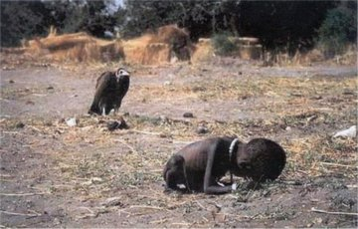
Photograph By Kevin Carter
Big Problem…

Slide 25
Thank You

